Slide 1

Player Performance Prediction using Machine Learning Algorithm Case Base Cricket in Kenya.
Name: 136446 - Mirav Hirji Bhojani
Supervisor: Mr. Kelvin Kibunja
Date: July 2023

Slide 2





Overview
Problem, Objectives and Justification
Related Work and Conceptual Framework
Methodology
Reference

Slide 3

Problem and Objectives
Problem
Over the years Kenya has seen a major downfall to cricket and some of the major reasons for this downfall are corruption, outdated technology and poor team management. The biggest problem is poor team management that is the selection of the starting eleven for the match and if the starting eleven is not chosen with the perfect combination the outcome for the match will turn out to be unfavorable.
Objectives
To examine and understand the current player selection process.
To review the challenges faced by the existing selection process.
Reviewing machine learning algorithms used in player selection.
To develop a classification model to predict player performances for future matches.
To test the proposed system using unit and integration testing.

Slide 4

Justification
The current starting eleven process is based on a few assumptions which is not reliable and also the outdated technology that Cricket Kenya is using thus lagging the nation behind in the game and it is because of that Kenya lost their fame in the game that it had back in the early 2000’s where Kenya was seen as the favorites for becoming the next big team after Bangladesh and Nepal.
With all this issues a system is proposed that aims to deal with the aspect of corruption and team management of course with the help of using advanced technologies.

Slide 5

Related Works
Data Mining System for Selecting a Winning Cricket Team
Machine learning-based Selection of Optimal
sports Team based on the Players Performance
A system that predicts players performance to help select a starting eleven team. Their focus was based on certain factors such as previous performance, height, style, average, strike rate, number of matches and number of innings played. This was achieved by developing a regression model however one of the issues was that some of the features used did not make sense to the prediction such as style which has no relation to performance as what matters is skills which any player can have. Thus, this leads to over fitting of data which can bias the performance of the player
The objective of this study and project was to help in selecting the team with the perfect combination of players to win the match. The technologies and algorithms used for this project are logistic regression, SVM and random forests. The data was obtained from IPL matches and trained for Indian players. Since it was trained and tested in Indian conditions and players it is then limited to Indian boundaries thus limiting the scope of the whole project to the whole world

Slide 6
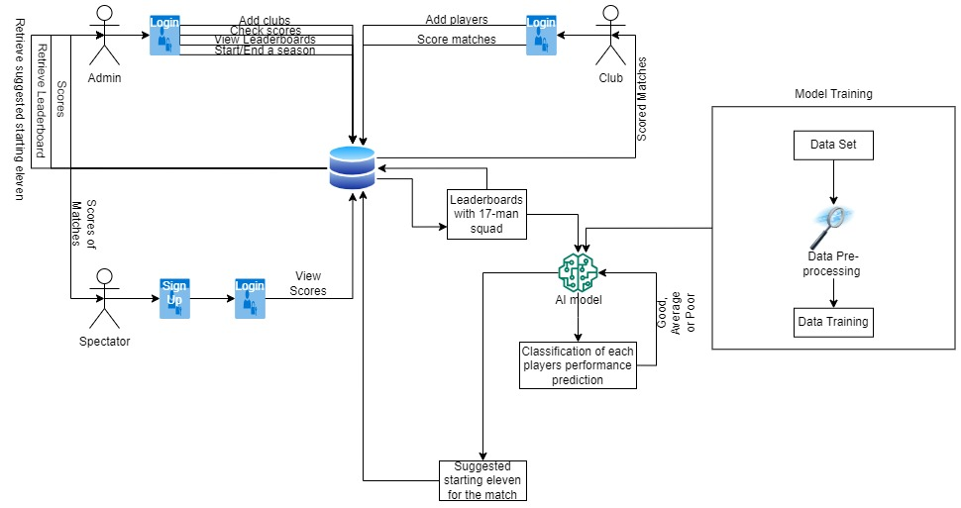
Conceptual
Framework

Slide 7
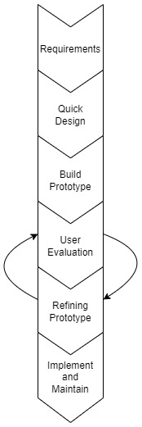

Methodology
Prototyping
Prototyping is chosen since it allows to develop a prototype system and allow user evaluation to allow any changes to the system before it is too late to change.
The specific prototyping methodology under prototyping chosen is Evolutionary prototyping since it allows constant refining of the existing prototype instead of developing a new one every time there is a change required

Slide 8


Deliverables
Proposal Document
Model and User Interface
Milestones
Completed Proposal Document
Scoring system
Model that predicts player performance and suggests the best starting eleven

Slide 9

References
Camburn, B. A., Dunlap, B. U., Kuhr, R., Viswanathan, V. K., Linsey, J. S., Jensen, D. D., ... & Wood, K. L. (2013, August). Methods for prototyping strategies in conceptual phases of design: framework and experimental assessment. In International Design Engineering Technical Conferences and Computers and Information in Engineering Conference (Vol. 55928, p. V005T06A033). American Society of Mechanical Engineers.
Monali Shetty, S. R. (2020). Monali Shetty; Sankalp Rane; Chaitanya Pandita; Suyash Salvi. IEEE.
Dinithi Hasanika, D. L. (2021). Data Mining System for Selecting a Winning Cricket Team. Projects- Department of Computer Engineering, University of Peradeniya, 34-45.
Desai, A. (2022). 2,000 Matches Are Streamed Live In CricHeroes. BW BusinessWorld, 14-17.
Jain, D. (2023). We Have a Clear Winner: Cricket Scoring Sheet Vs CricHeroes Online Cricket Scoring App. Medium, 23-23.
Mehta, N. (2020). Let’s Be Honest: Cricket is Dying a Slow, Yet Avoidable Death. Medium, 3.

Slide 10

Thank You

